Slide 1
PITCH Chris Plack chris.plack@manchester.ac.uk

Slide 2
Learning Outcomes
Understand how pitch is defined, and what aspects of a sound determine its pitch
Understand the place and temporal theories of the pitch of pure tones
Understand the difference between resolved and unresolved harmonics, and the pattern recognition and temporal theories of the pitch of complex tones
Understand how pitch may be represented in the central auditory system

Slide 3

Sound waves that repeat over time (i.e. periodic sound waves) are often heard as having a musical pitch:
Periodic:
Non-periodic:
Time

Slide 4
Definition of Pitch
Pitch is the sensation whose variation is associated with musical melodies.
Pitch is the sensation corresponding to the repetition rate of sound waveforms.
Sounds that repeat at the same rate tend to have the same pitch, regardless of their spectra…

Slide 5
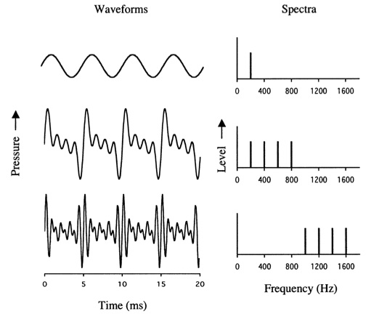
Same Pitch
Pure Tone:
Complex Tones:

Slide 6
Pitch of Pure Tones

Slide 7
Pitch of Pure Tones
Pure tones have a single frequency component.
The frequency of a pure tone is represented in two different ways:
By the place of excitation in the cochlea
By the phase-locked temporal firing patterns of auditory neurons
But which gives us the sensation of pitch?

Slide 8
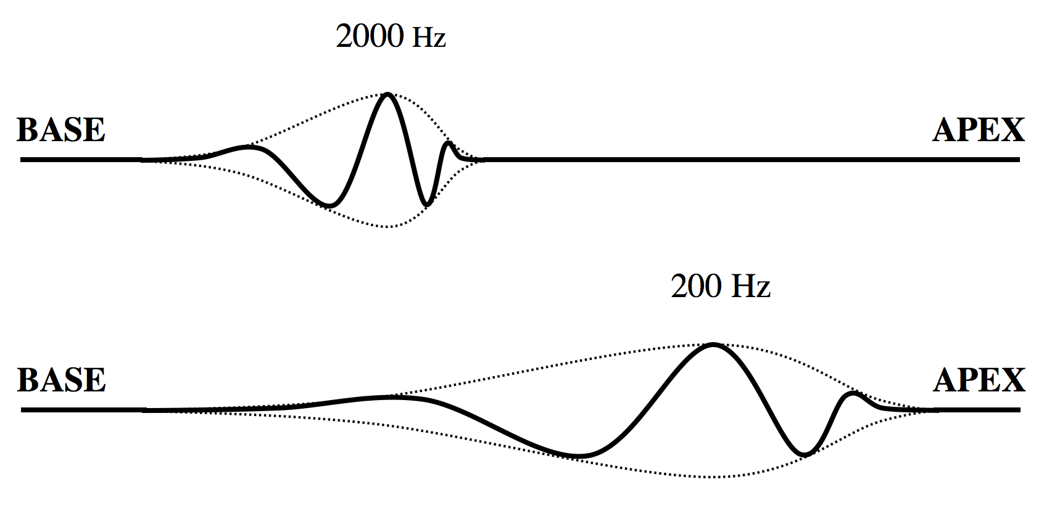
Basilar Membrane

Slide 9
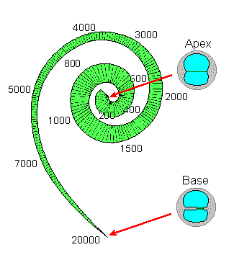
Place Coding on Basilar Membrane

Slide 10
Organ of Corti
Stereocilia
Inner Hair Cell
Outer Hair Cells
Basilar Membrane

Slide 11
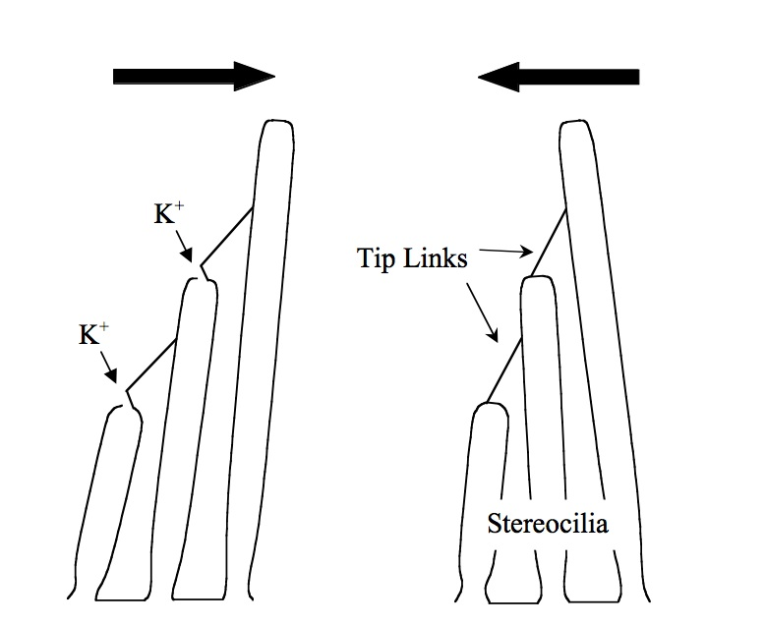
Transduction
When the stereocilia are bent in one direction, tip links stretch and open ion channels.
Positively-charged potassium ions enter the cell causing it to become “depolarised.”

Slide 12
Transduction
Displacement of Basilar Membrane
The inner hair cells depolarise, and release neurotransmitter, only when the stereocilia are bent in one direction:
Inner Hair Cell
Auditory Nerve Fiber

Slide 13
Vibration of Basilar Membrane
Phase Locking
Displacement
Auditory Nerve Spikes
Single Fibers
Auditory nerve fibres produce spikes that are phase-locked (synchronised) to the vibration of the basilar membrane:
Electric Potential
Many Fibers

Slide 14
Temporal Coding of Pitch
The frequency of a pure tone is represented in terms of periodic temporal patterns of neural activity, for frequencies up to about 5 kHz:
Low Frequency
High Frequency
Neural Impulses:

Slide 15
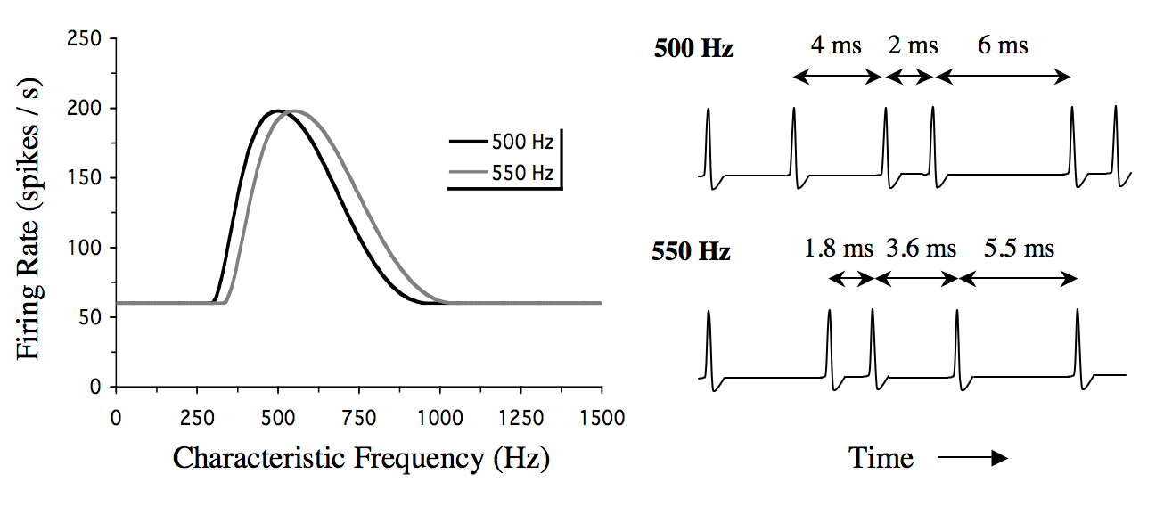
Place vs. Temporal Coding of Pure Tone Frequency in Auditory Nerve
Place
Temporal

Slide 16
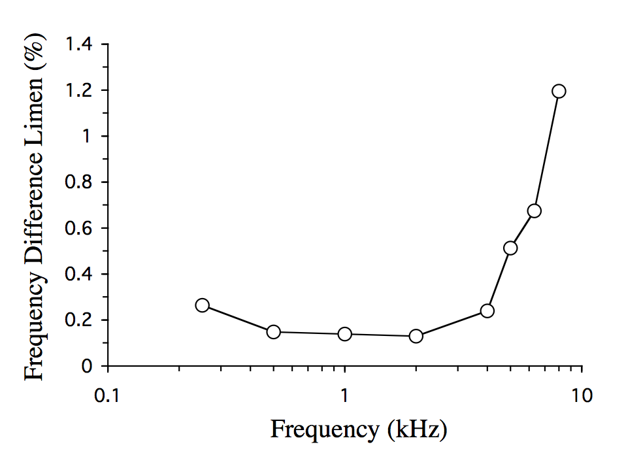
Frequency Discrimination for Pure Tones
Limit of phase locking
Moore (1973, JASA 54, 610)

Slide 17
Place vs. Temporal Coding
Frequency discrimination for pure tones below 5 kHz may be too good to be explained by a place code.
Also, the sense of musical pitch is lost above 5 kHz. This coincides with the frequency limit of phase locking.
Many researchers think that the pitch of pure tones is coded temporally.

Slide 18
Pitch of Complex Tones

Slide 19
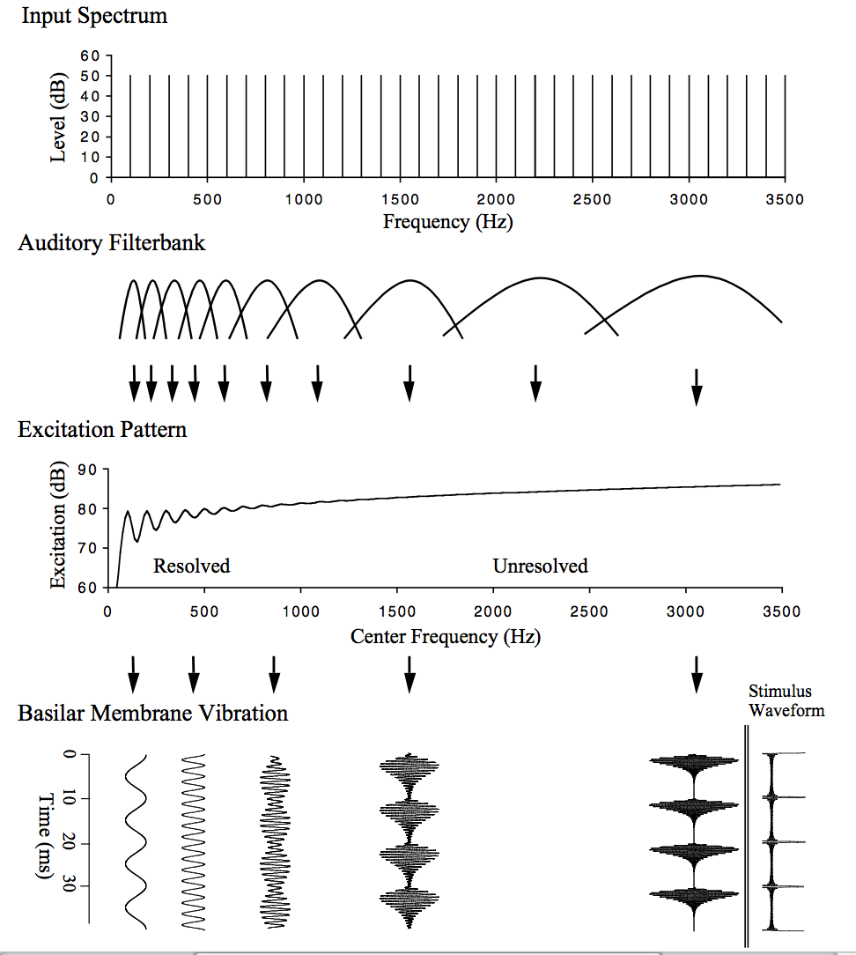
Representation of Complex Tones
Lower harmonics are separated out, i.e. “resolved,” and contribute more to pitch than the higher “unresolved” harmonics:

Slide 20
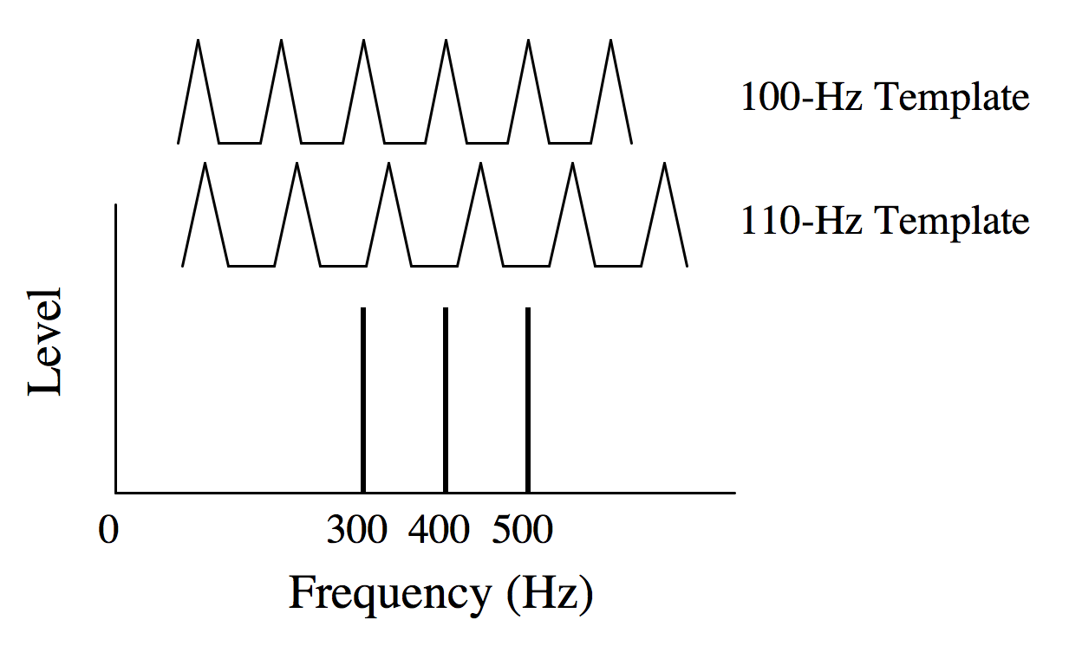
Pattern Recognition Models
Pattern-recognition models assume that pitch is extracted from the pattern of the resolved harmonics across frequency, perhaps by a neural harmonic template:
(Note that the frequencies of the resolved harmonics could be coded by a place or by a temporal representation)

Slide 21
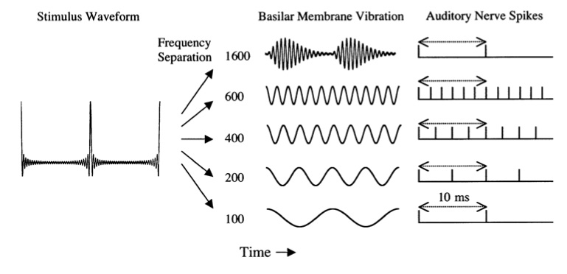
Temporal Models
Modern temporal models assume that pitch is extracted from the phase-locked neural firing across characteristic frequency:

Slide 22
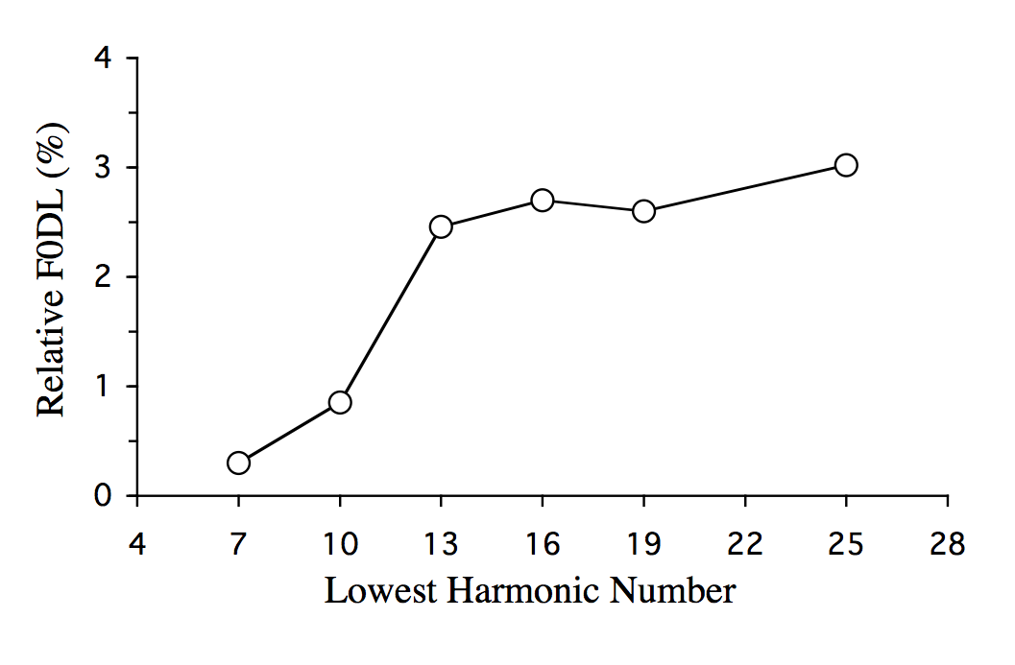
Resolved vs. Unresolved Harmonics
Resolved harmonics produce a stronger representation of pitch:
Unresolved
Resolved
Houtsma and Smurzynski (1990, JASA 87, 304)

Slide 23
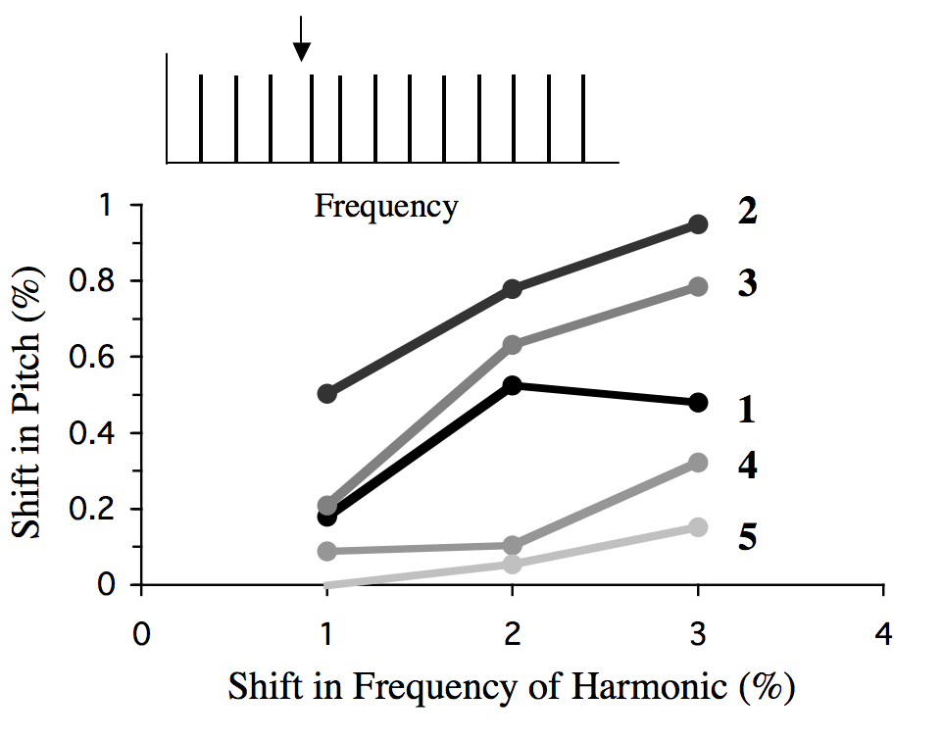
Dominant Region
Low-numbered resolved harmonics contribute more to pitch than do higher harmonics:
Moore et al. (1985, JASA 77, 1853)

Slide 24
Pattern Recognition vs. Temporal Models
Resolved harmonics have a much stronger influence on pitch than do unresolved harmonics – support for pattern recognition.
But a clear musical pitch can be obtained from unresolved harmonics only, suggesting that temporal information alone can be used to produce a pitch.
Over last twenty years or so, temporal models that combine information from resolved and unresolved harmonics have held sway, however…

Slide 25
Oxenham et al. (2011, PNAS 108, 7629). Pitch matching and melody discrimination possible for complex tones with harmonics above 5 kHz. Evidence for place coding / pattern recognition models?

Slide 26
Representation of Pitch in the Auditory Brain

Slide 27
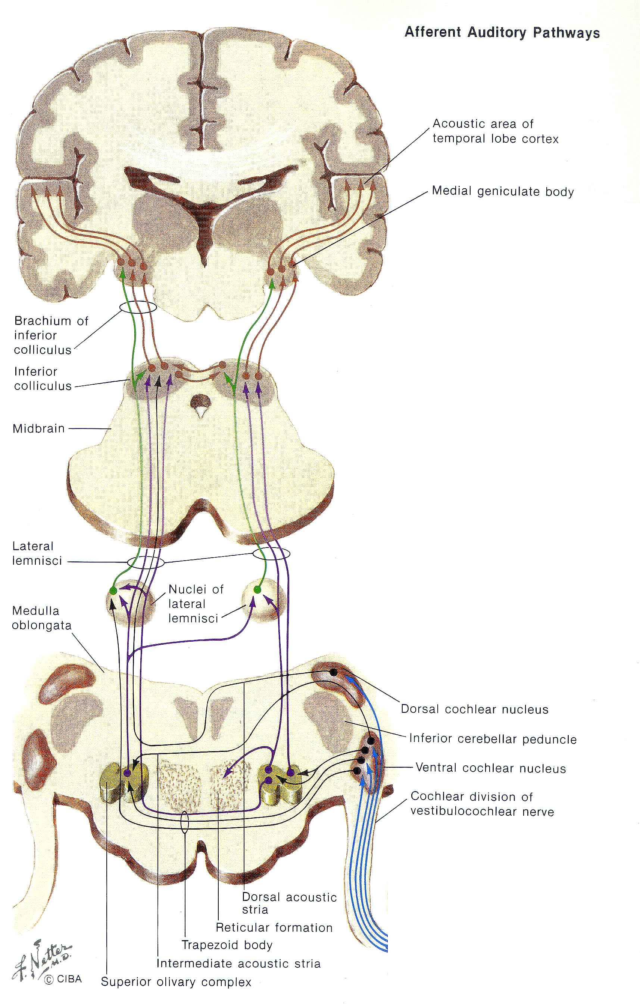
Central Auditory System
Cochlear Nucleus
Superior Olivary Complex
Lateral Lemniscus
Inferior Colliculus
Medial Geniculate Body
Auditory Cortex

Slide 28
Frequency-Following Response
The frequency-following response (FFR) is an electrophysiological measure of phase locking in the brainstem.
Periodic patterns of vibration produce periodic patterns of neural activity, which produce periodic variations in the scalp potential.

Slide 29
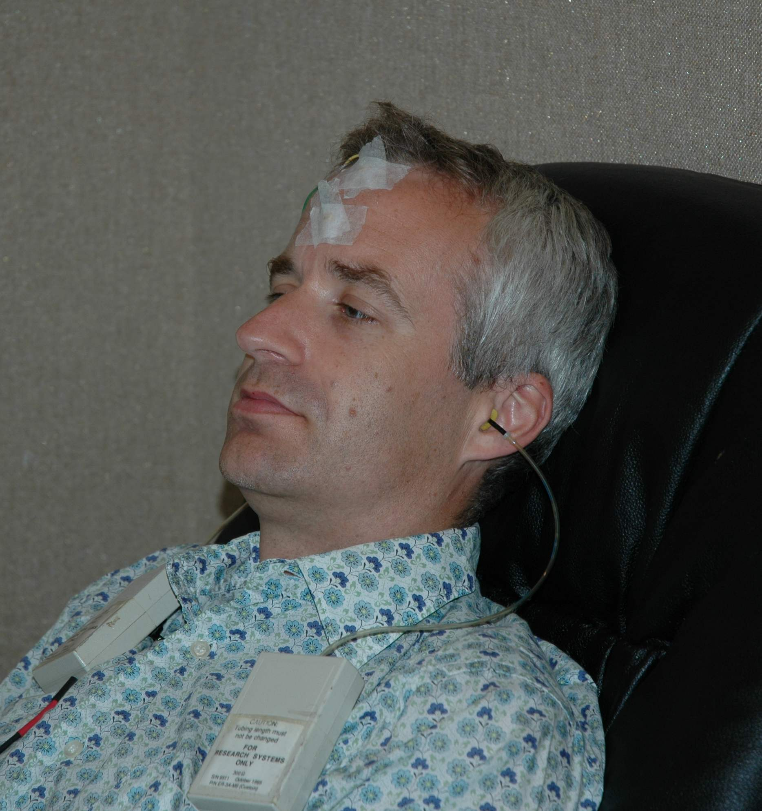
Electrode Positions
+

Slide 30
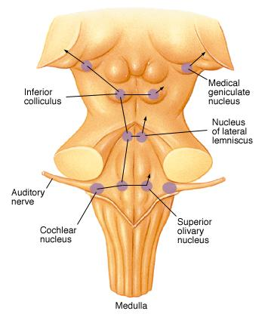
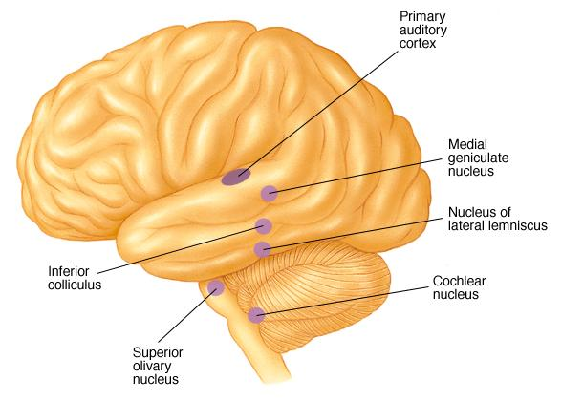
Probable main generation sites

Slide 31
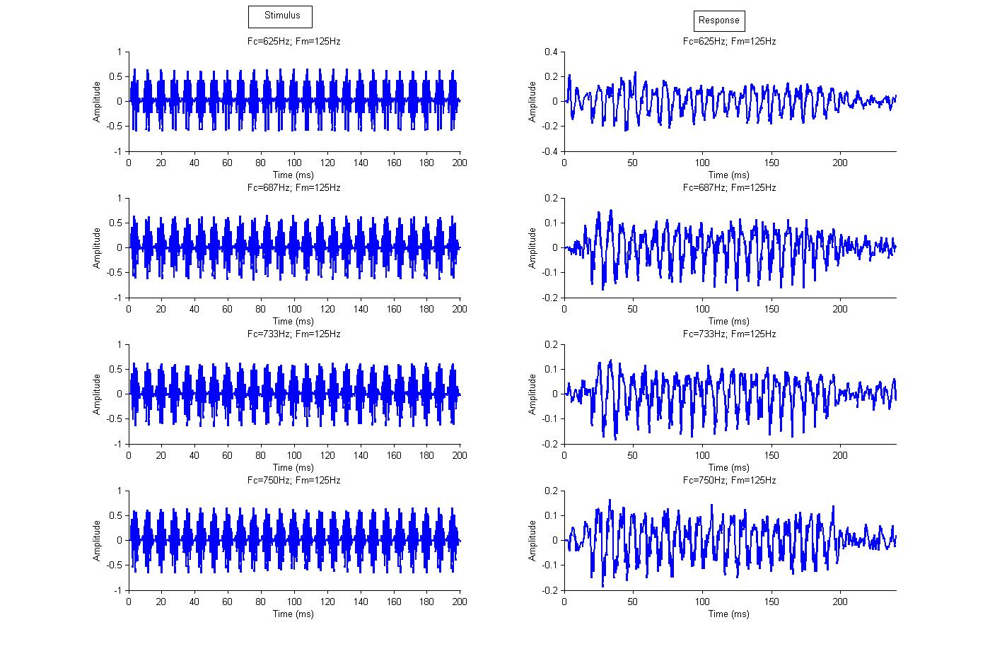
Stimulus
Scalp Potential
Time

Slide 32
Gockel et al. (2011, JARO 12, 767)

Slide 33
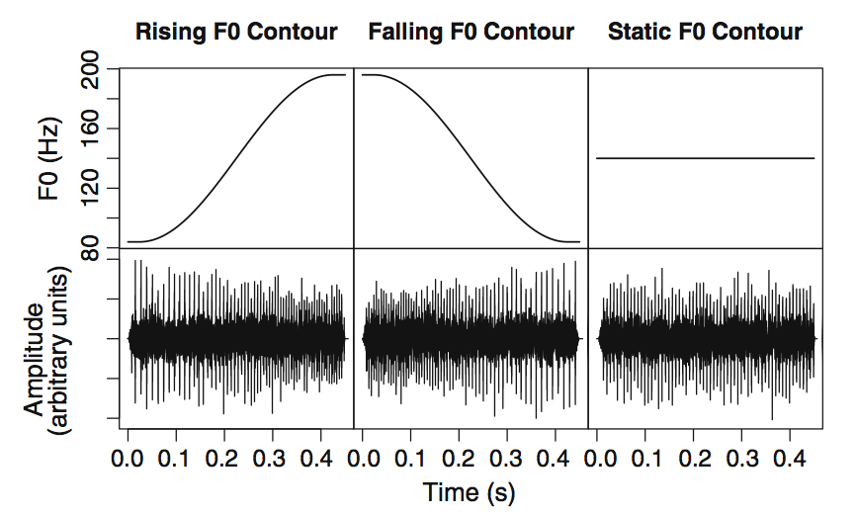
FFR and Pitch Learning

Slide 34
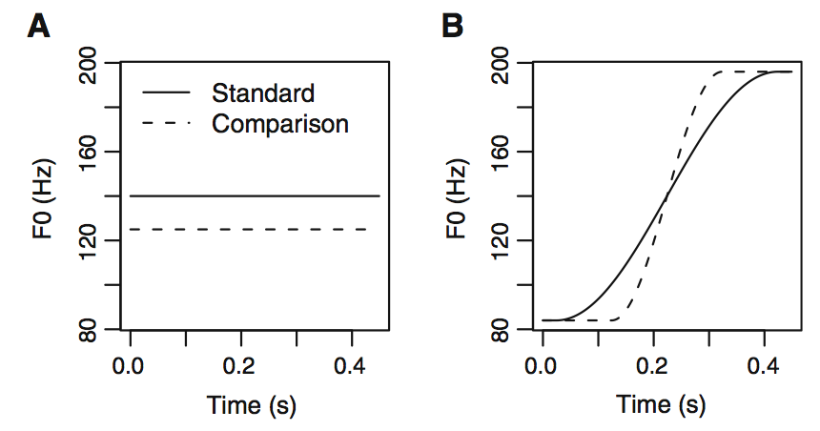
FFR and Pitch Learning

Slide 35
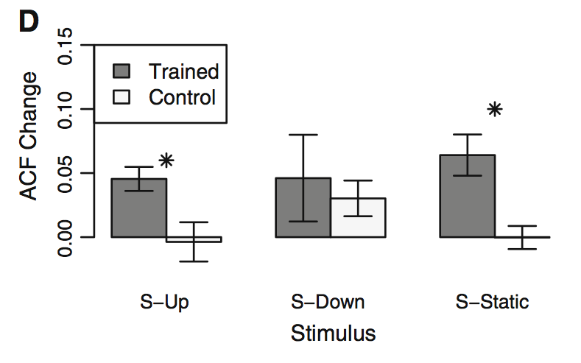
FFR strength increases after 20 hours pitch discrimination training:
Carcagno & Plack (2011, JARO 12, 89)

Slide 37
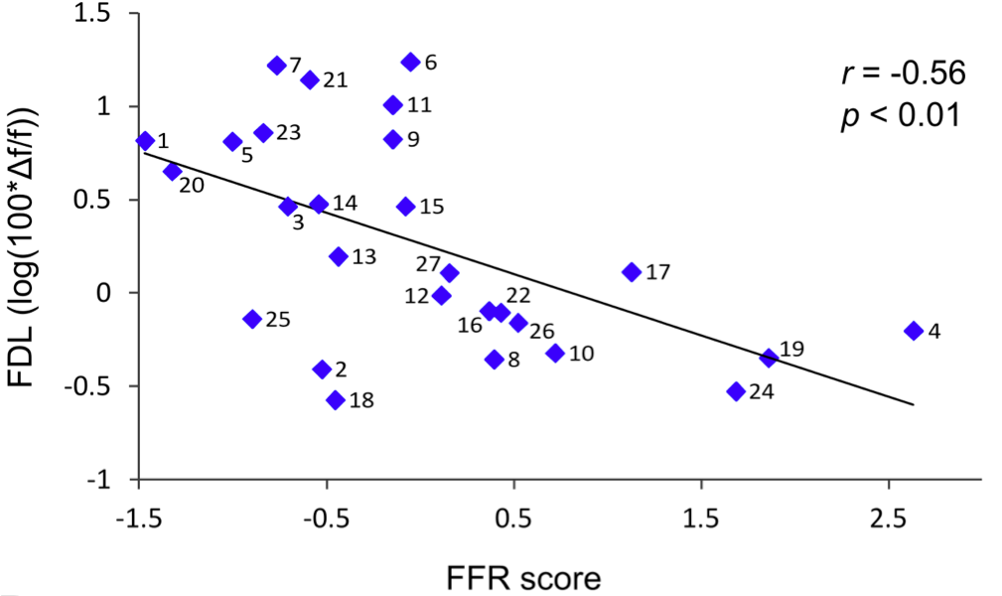
FFR and Frequency Discrimination
FFR strength correlated with pure-tone frequency discrimination – evidence for temporal coding?
Marmel et al. (2013, JARO 14, 757)

Slide 38
Where in the Auditory Cortex is the General “Pitch Centre”?

Slide 39
The Search for a “Pitch Centre”
Many different types of stimulus can produce a musical pitch.
The fact that these stimuli can produce the same sensation implies that at some stage in the auditory pathway their representations converge.
Where does this convergence occur?

Slide 40
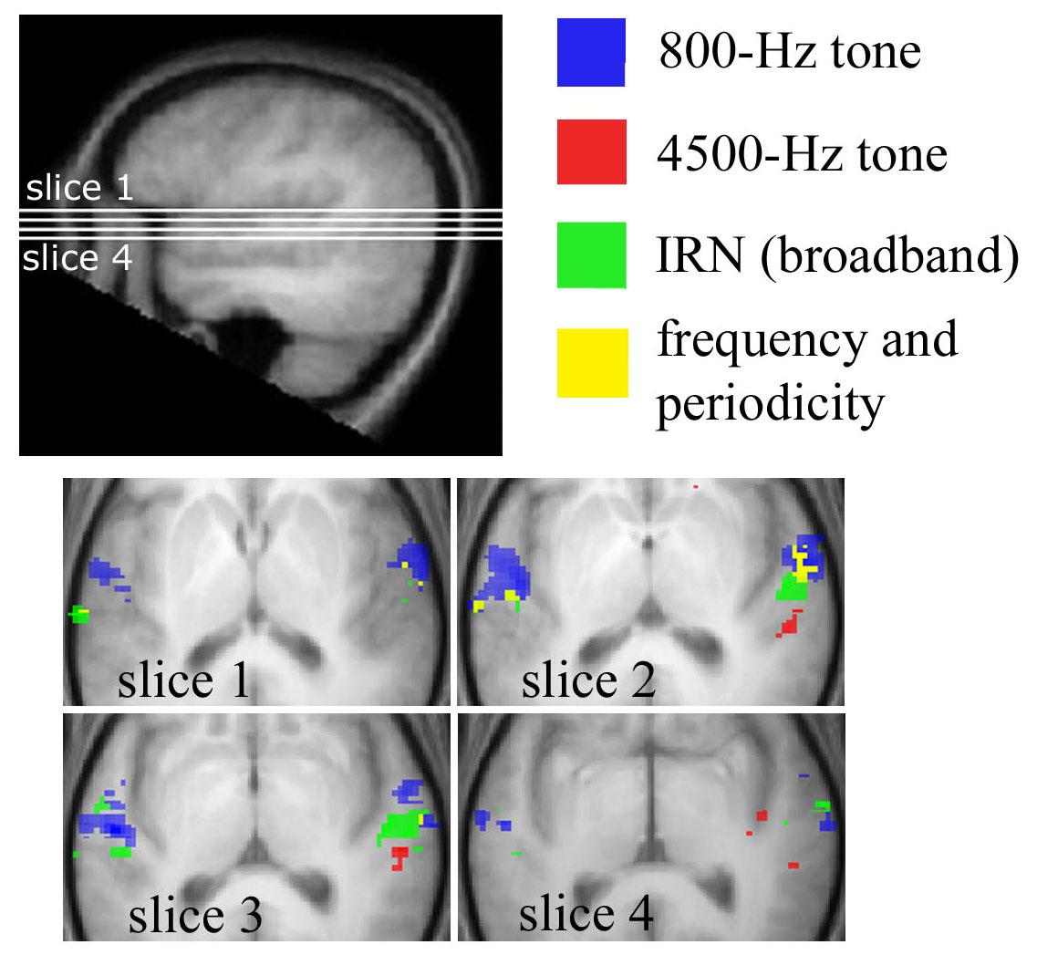
Human fMRI response to iterated ripple noise (IRN) suggests a locus in lateral Heschl’s Gyrus (HG):
Hall et al. (2006, Eur. J. Neurosci. 24, 3601)

Slide 41
However, a general “pitch centre” should respond to all pitch-evoking stimuli, irrespective of spectral and binaural characteristics.
To test the lateral HG hypothesis, Deb Hall and I used several different pitch-evoking stimuli.
All had a pitch corresponding to 200 Hz, and all were matched in level and overall spectrum to a 2-kHz lowpass noise.

Slide 42
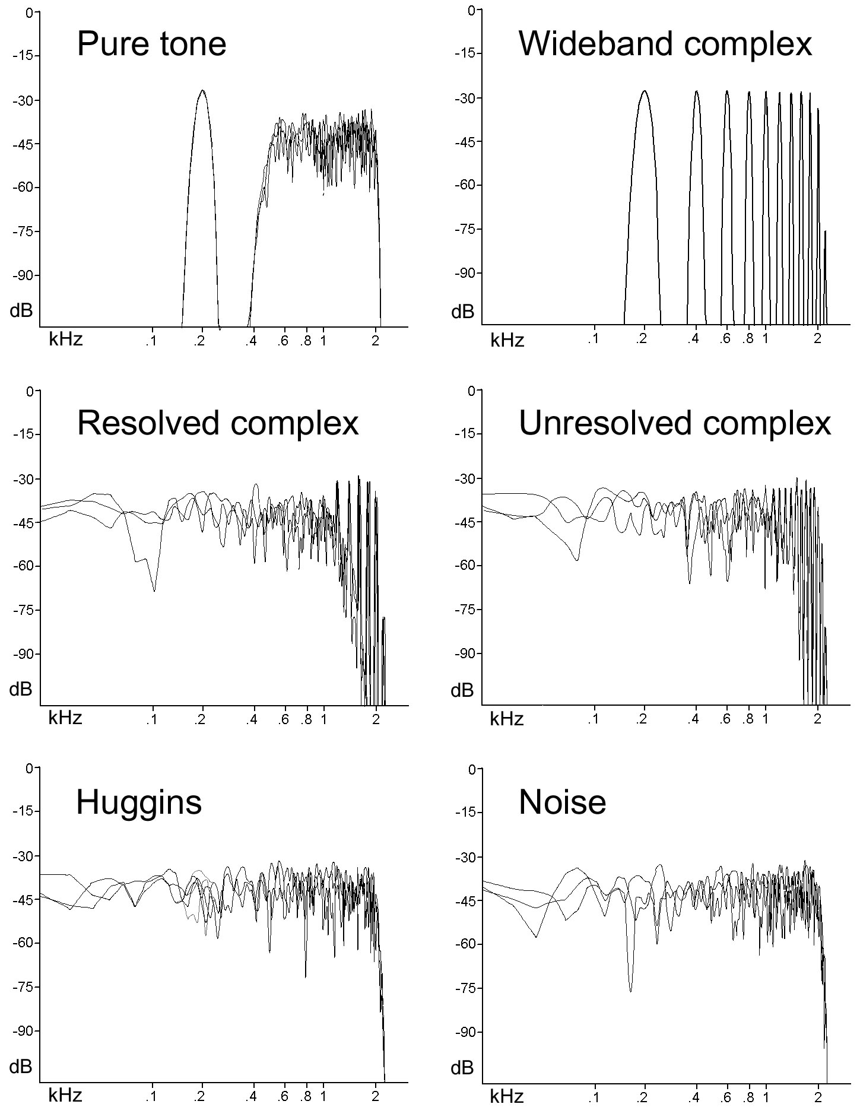
Hall and Plack (2009, Cereb. Cort. 19, 576)

Slide 43
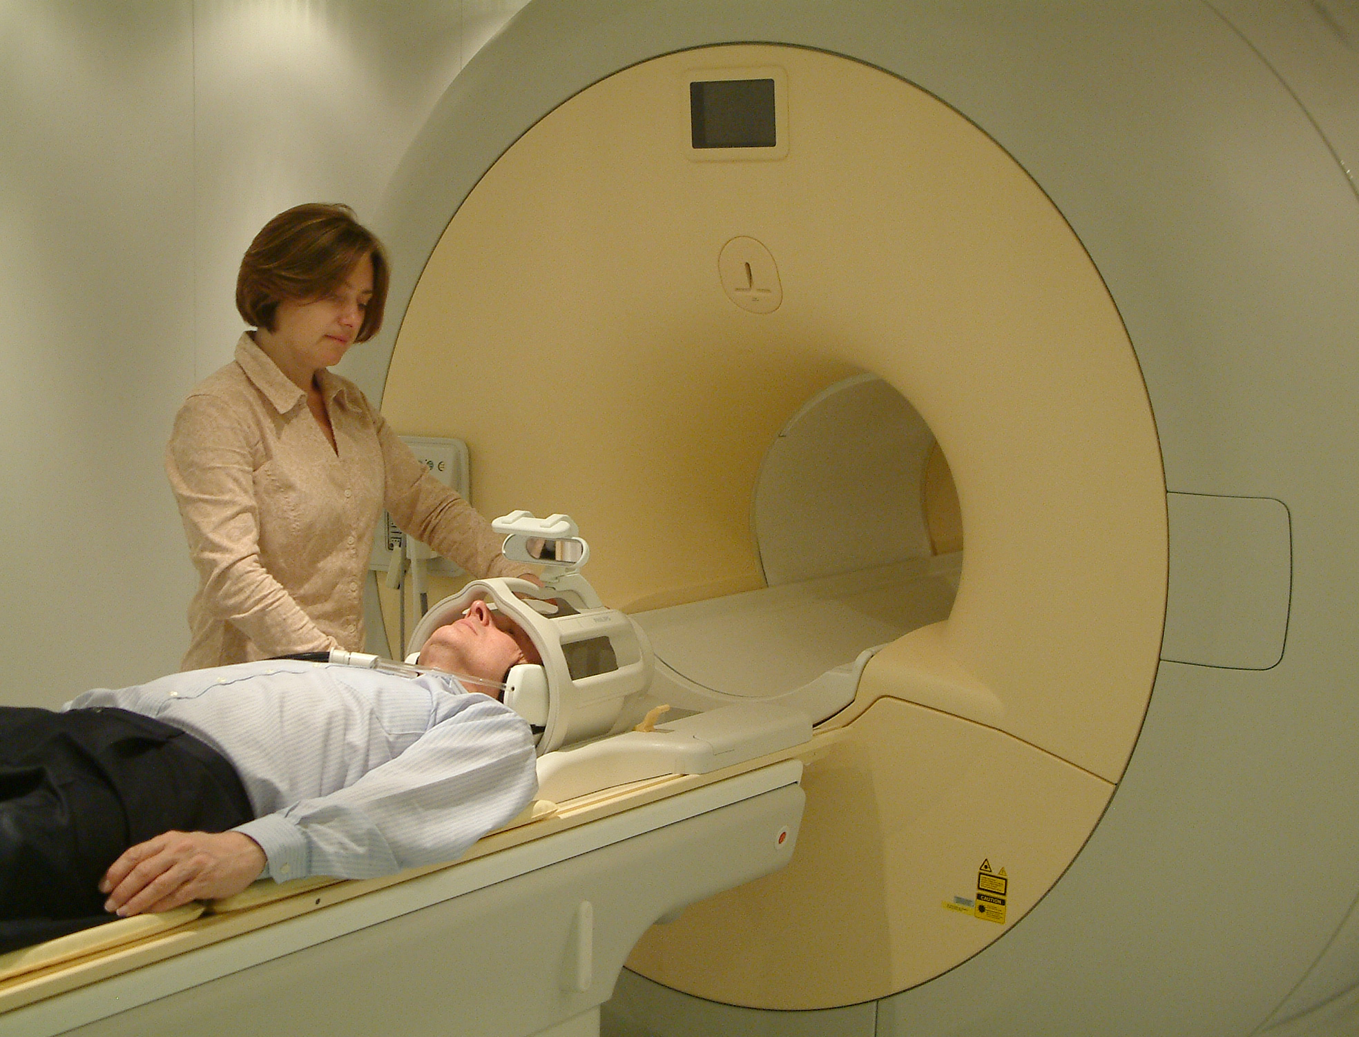
16 listeners, Philips 3T scanner:

Slide 44
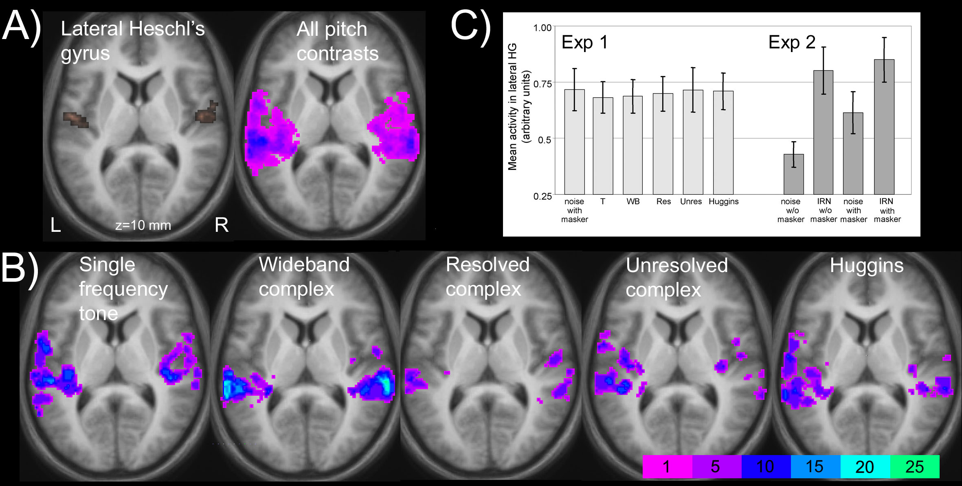
Pitch vs. Noise
Sum of the separate activation maps (p<0.01)
All five pitch conditions had a similar probability distribution across the auditory cortex.
Left
Right
Probability (%)

Slide 45
Activation in Lateral HG

Slide 46
In contrast to the earlier IRN results, none of the stimuli produced significant differential activation in lateral HG!
The most common locus was in planum temporale, posterior to HG, although there were individual differences.
……so what’s going on?

Slide 47
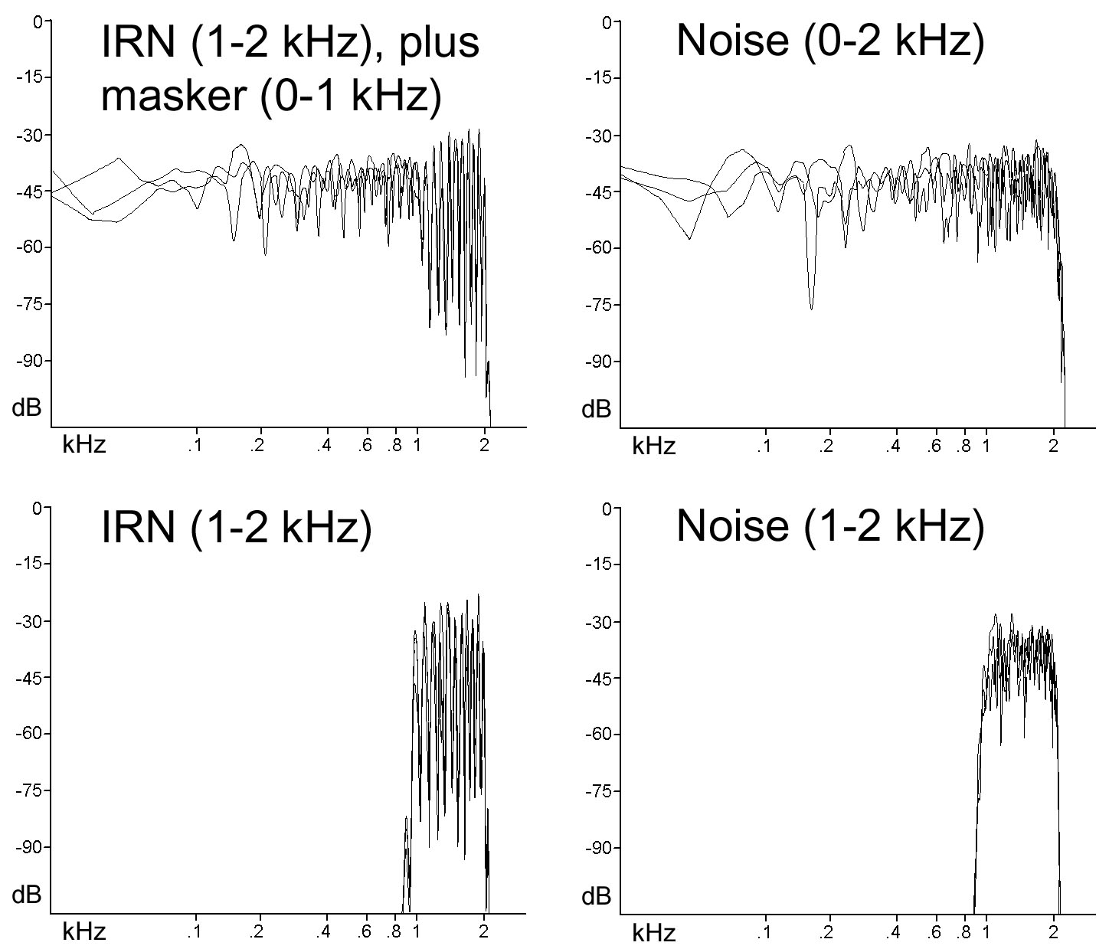
We decided to try to replicate the IRN results (nine listeners):
10-ms delay, 16 iterations

Slide 48
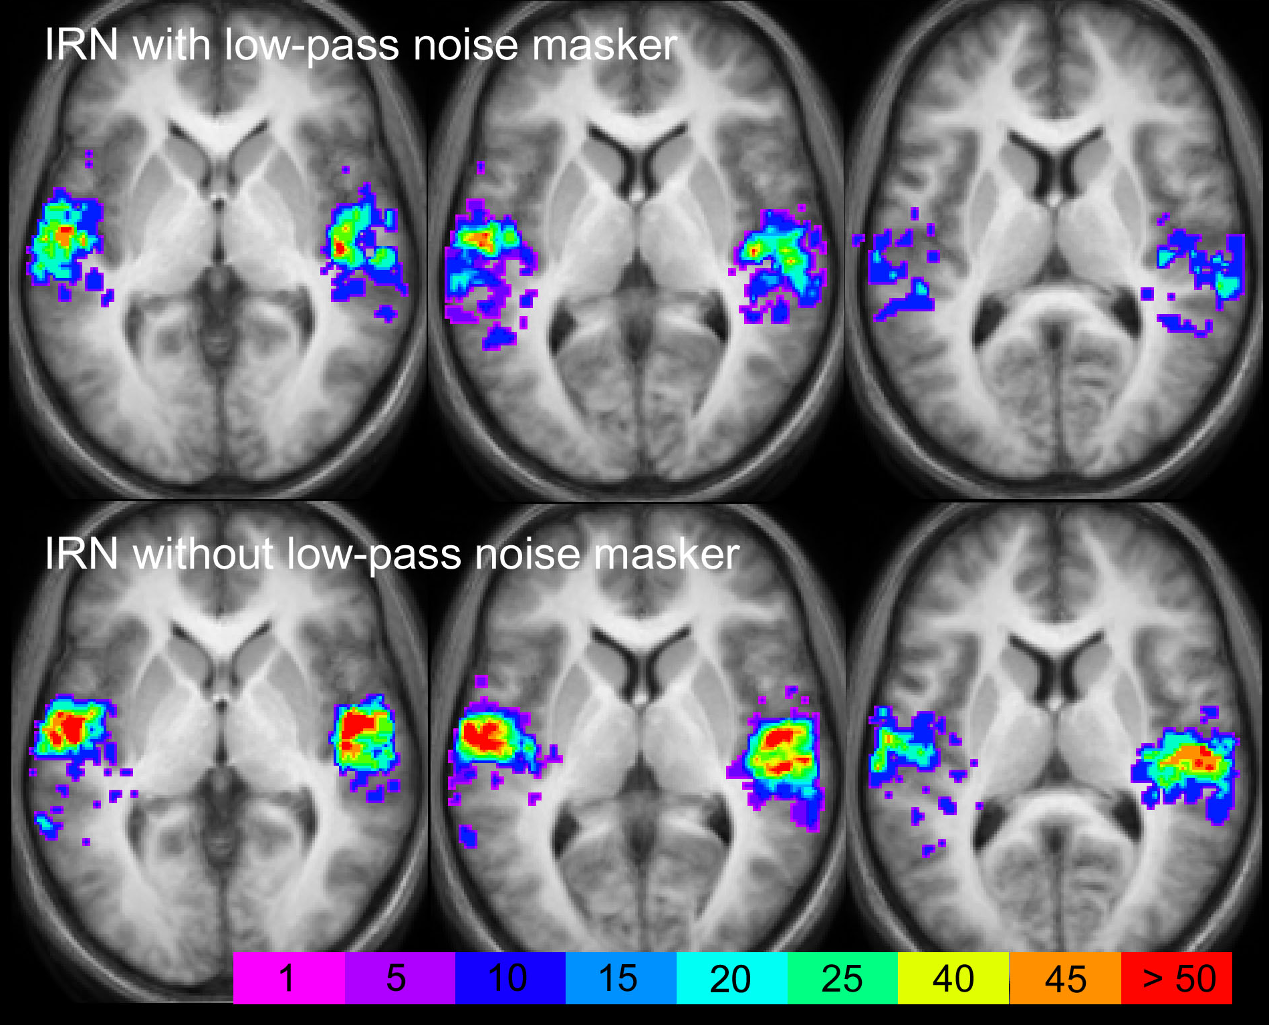
IRN vs. Noise
Z= 0
Z= 5
Z= 10

Slide 49
Z= 0
Z= 5
Z= 10

Slide 50
Activation in Lateral HG

Slide 51
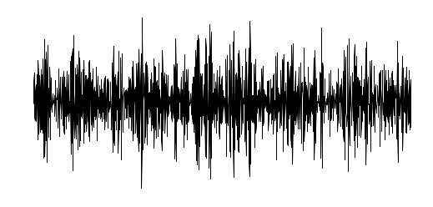
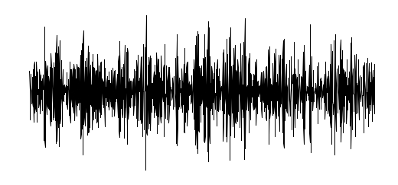
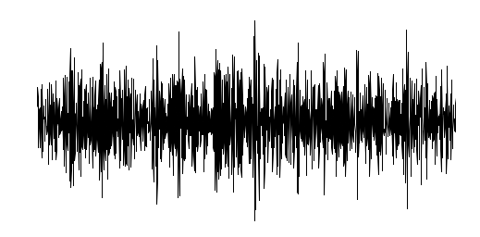
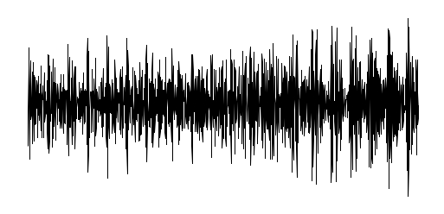
How IRN is Made
Take sample of noise:
+
Delay and add back to original:
=
Repeat n (16) times:
Time

Slide 52
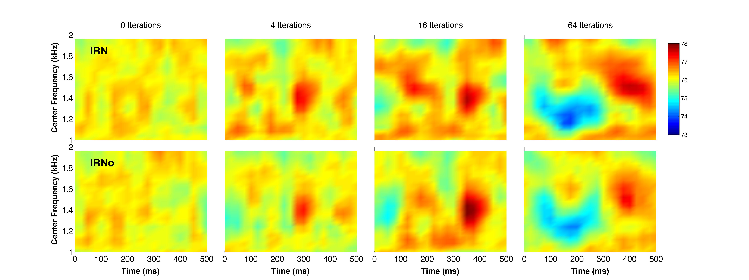
Output of nonlinear auditory filterbank and temporal smoothing by temporal window: IRN contains slowly varying spectro-temporal features unrelated to pitch! Can process IRN to remove fine structure regularity (and hence pitch) while leaving the slowly varying features (IRNo).

Slide 53
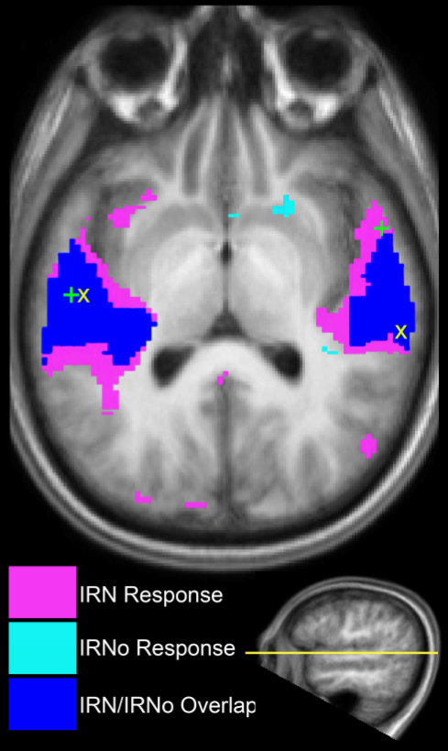
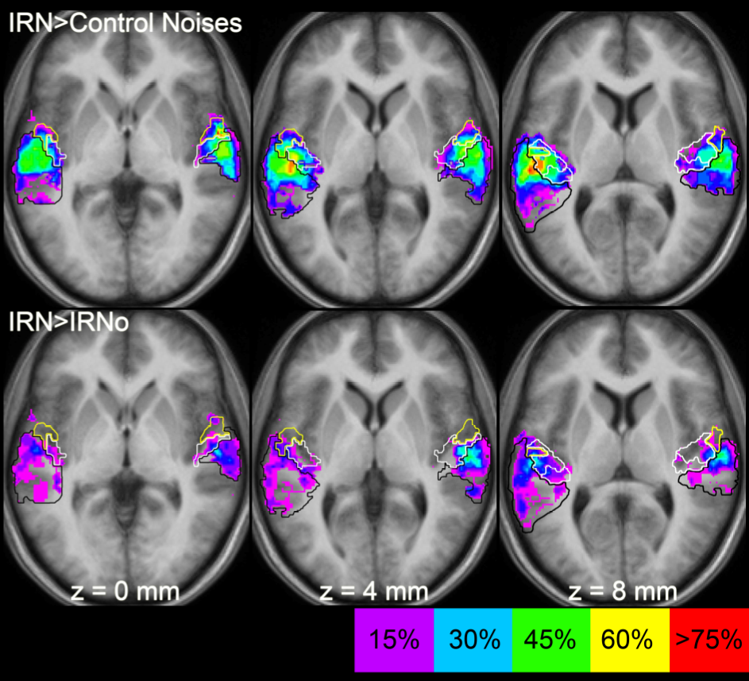
Barker et al. (2012, Cereb. Cort. 22, 745). IRN and IRNo produce similar activation: Response to IRN reported previously probably largely driven by modulations, not pitch:

Slide 54
Pitch
Learning Outcomes
Understand how pitch is defined, and what aspects of a sound determine its pitch
Understand the place and temporal theories of the pitch of pure tones
Understand the difference between resolved and unresolved harmonics, and the pattern recognition and temporal theories of the pitch of complex tones
Understand how pitch may be represented in the central auditory system

Slide 55
Reading
Plack (2018). “The sense of hearing (3rd Ed.)” (Routledge, Oxford). Chapter 7.
Oxenham et al. (2011). “Pitch perception beyond the traditional existence region of pitch,” Proceedings of the National Academy of Sciences 108, 7629–7634.
Vershooten et al. (2019). “The upper frequency limit for the use of phase locking to code temporal fine structure in humans: A compilation of viewpoints,” Hearing Research 377, 109-121.

Slide 56
Binaural Pitch – Where are Harmonics Combined?

Slide 57
Huggins Pitch
Huggins pitch is produced by introducing a narrow frequency band of interaural decorrelation in a noise that is otherwise correlated between the two ears:
Same noise in each ear
Different noise in each ear
Frequency

Slide 58
Can Huggins pitch harmonics be combined with diotic harmonics to produce a residue pitch?
Mixed-mode conditions (1 HP + 1 NBN):
Single-mode conditions (2 HP or 2 NBN):

Slide 59
Present two successive pairs of harmonics. Does pitch change follow analytic (spectral) or synthetic (residue) pitch?
Frequencies | F0 (Hz) | Harmonic Numbers
400 + 800 | 400 | 1st & 2nd
533 + 800 | 267 | 2nd & 3rd
640 + 800 | 160 | 4th & 5th

Slide 60
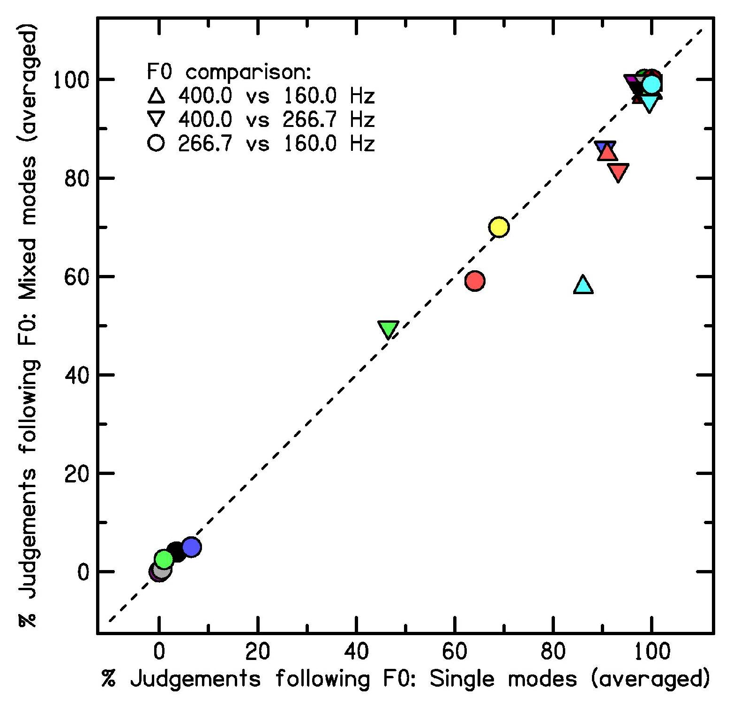
Response of listeners for mixed-mode and single-mode conditions highly correlated:
Gockel, Carlyon, & Plack (2010, JARO)
Suggests Huggins and diotic harmonics are processed by the same mechanism and combined after MSO.

Slide 61
The Coding of Musical Harmony and the Effects of Age

Slide 62
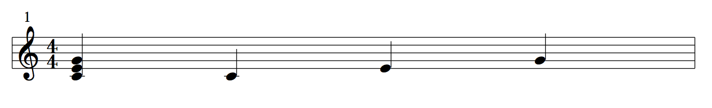
Harmony refers to the simultaneous combination of notes to form chords:
C major triad
melody
harmony
G
C
E
G
E
C

Slide 63
Consonance (pleasantness) ratings for dyads (two-note chords):
Perfect fifth
Pleasantness Rating
Tritone
Interval Between Notes (semitones)
McDermott et al. (2010)

Slide 64
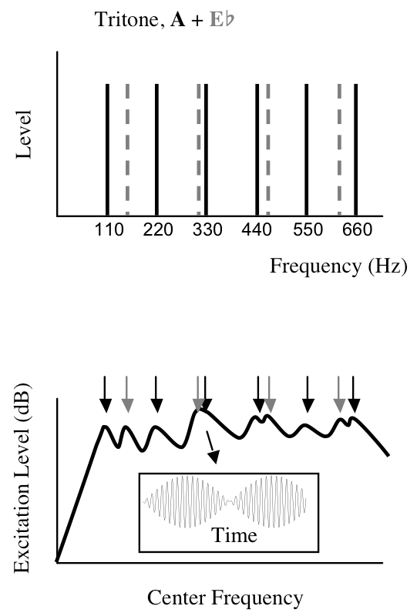
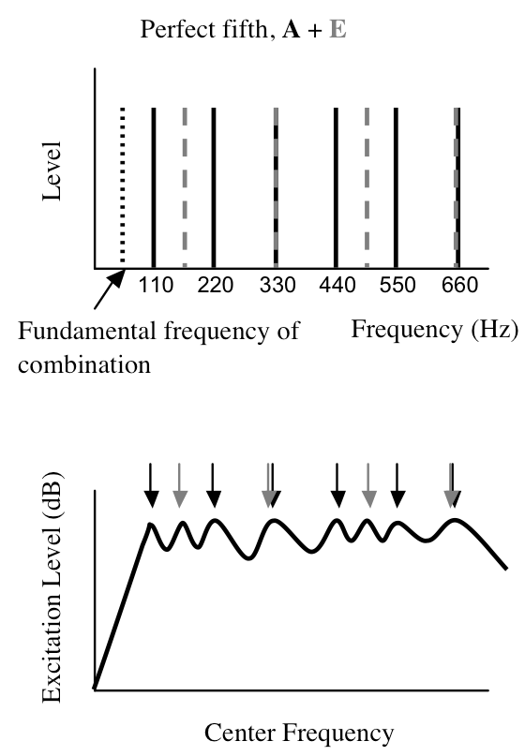

Slide 65
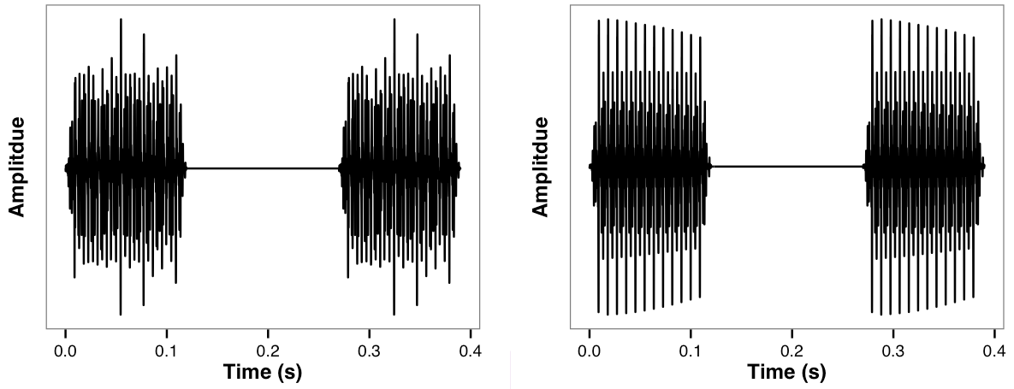
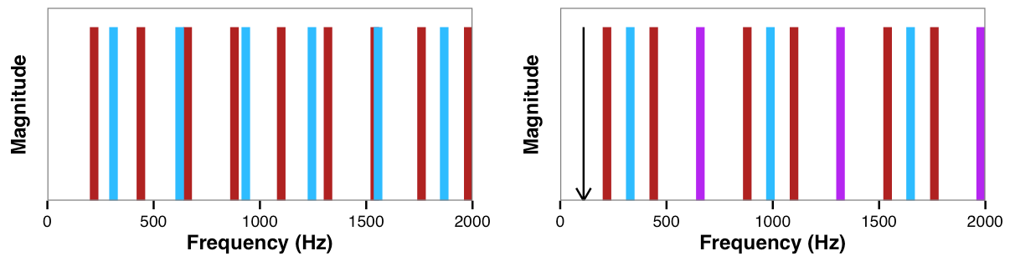
Tritone
Perfect 5th

Slide 66
FFR:

Slide 67
Bones and Plack (2014a, Neuropsychologia)

Slide 68
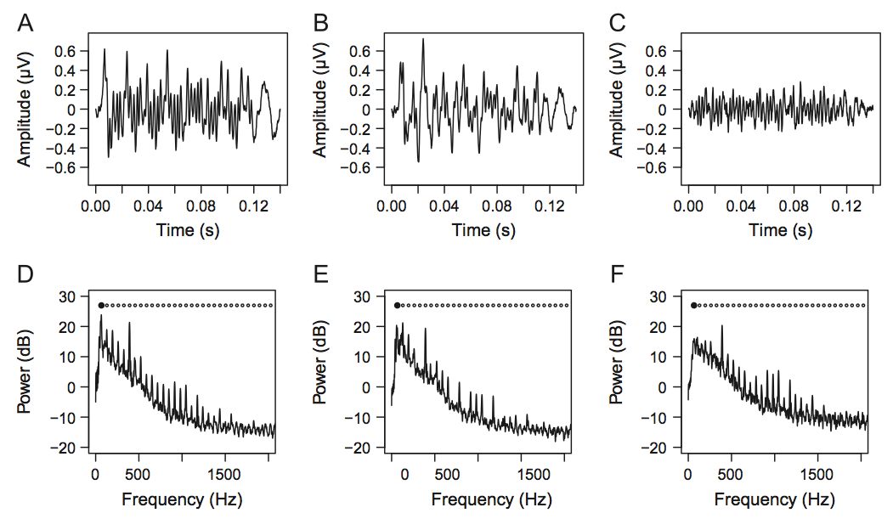
P5 FFR raw diotic
FFR raw dichotic
FFR sub diotic
Bones and Plack (2014a, Neuropsychologia)

Slide 69
Individual differences in the neural coding of harmonicity predict individual differences in consonance preference for young, normal-hearing adults without musical experience:
Bones and Plack (2014c)

Slide 70
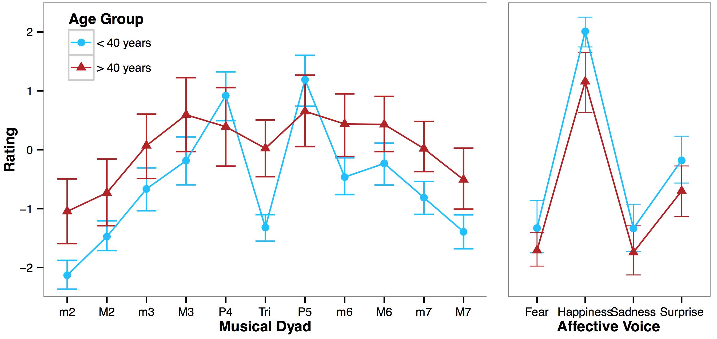
Ageing impacts on musical consonance perception even for listeners with normal hearing:
Bones and Plack (2014b)

Slide 71
FFR:

Slide 72
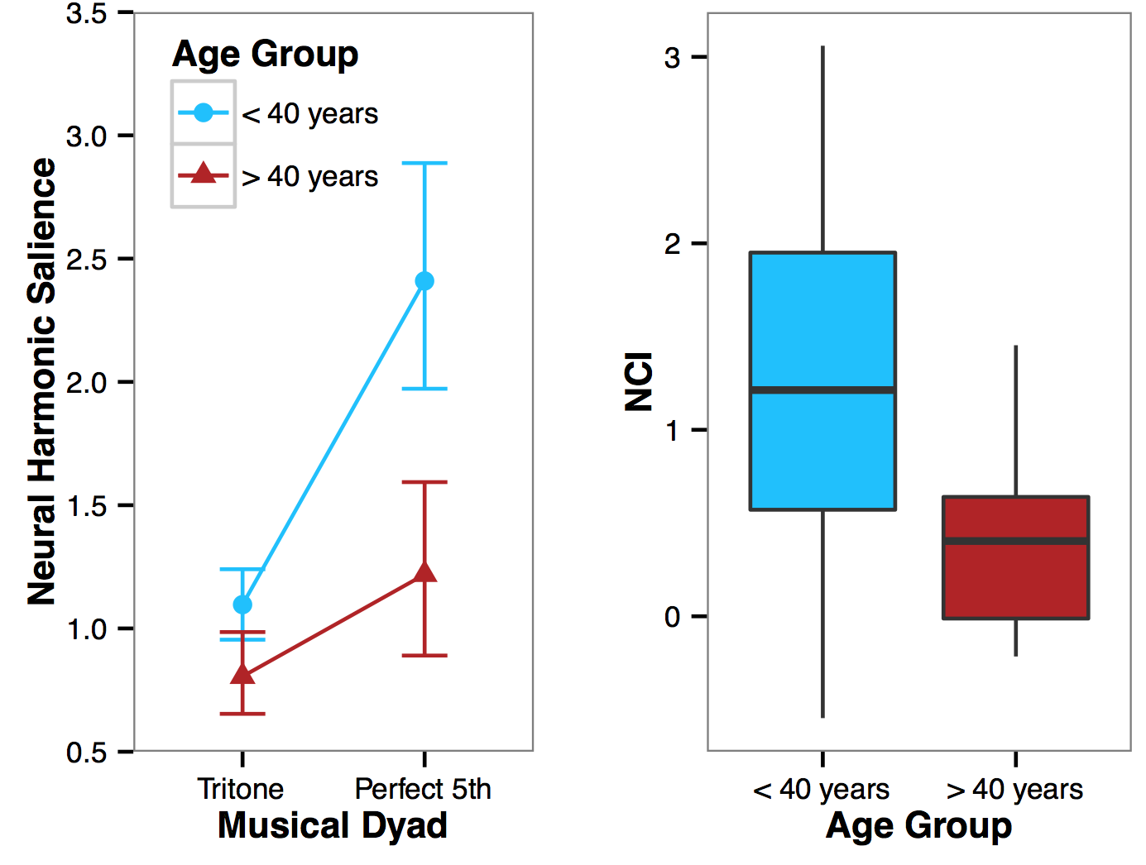
Decline in consonance perception is reflected in decline in neural coding of harmonicity measured using FFR:
Bones and Plack (2014b)

Slide 73
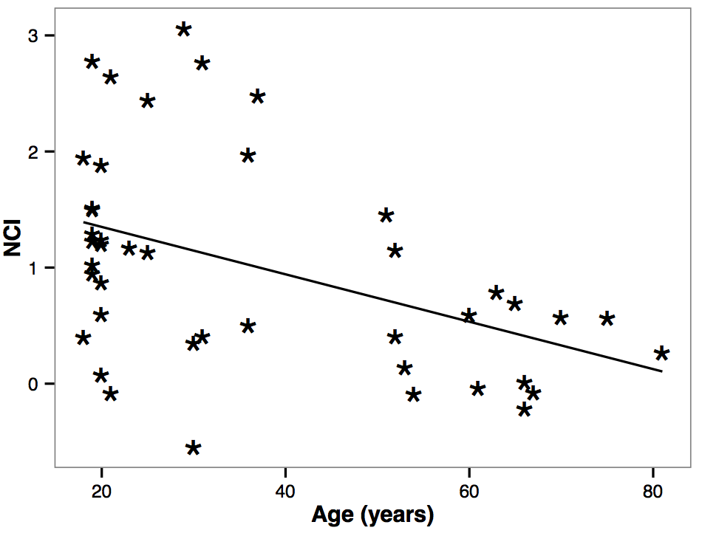
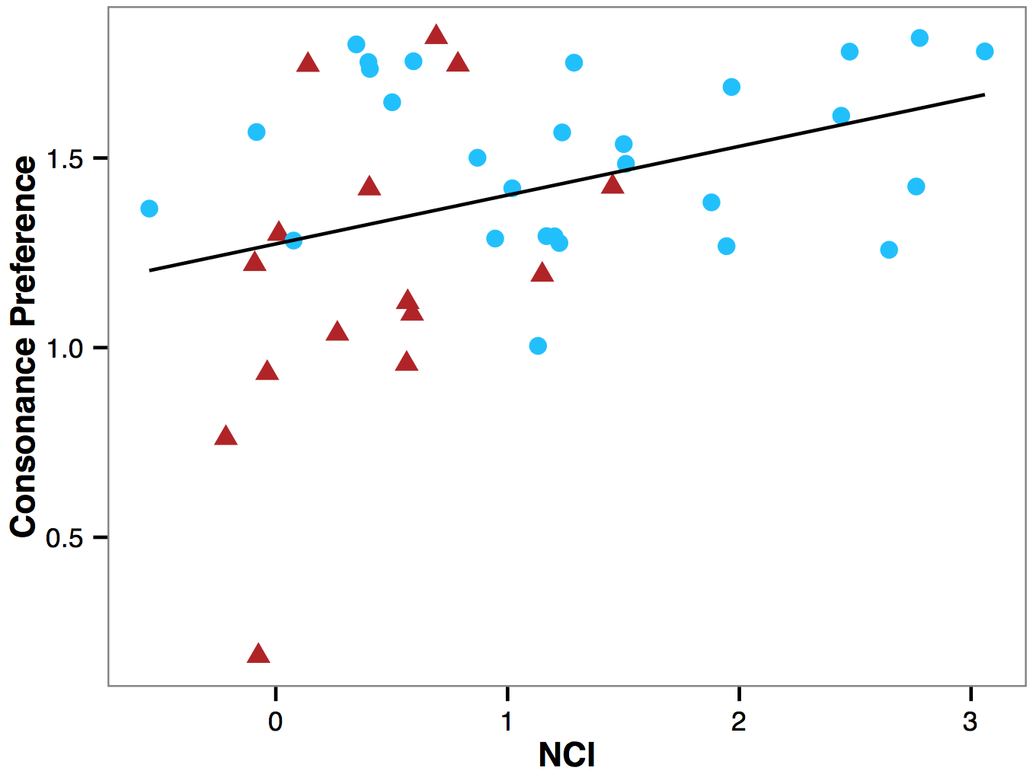
Neural coding of harmonicity correlates with age and consonance preference:
Bones and Plack (2014b)

